Slide 1
感受Lambda无服务器架构
实现 CloudWatch 循环告警

Slide 2
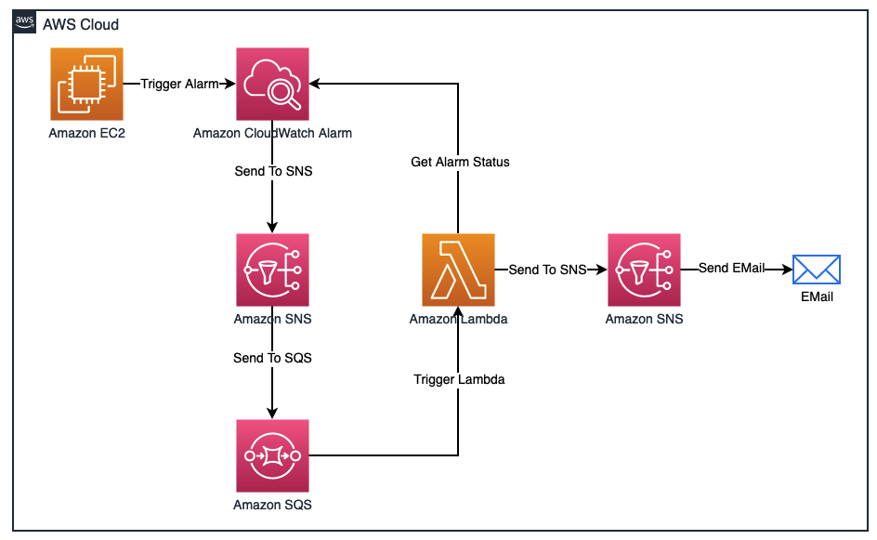
整体架构一览

Slide 3
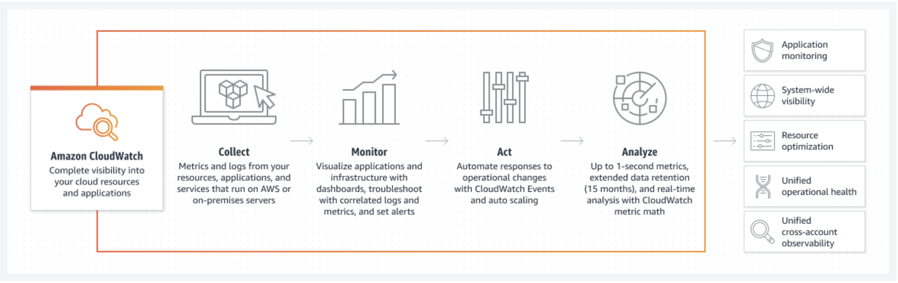
CloudWatch

Slide 4
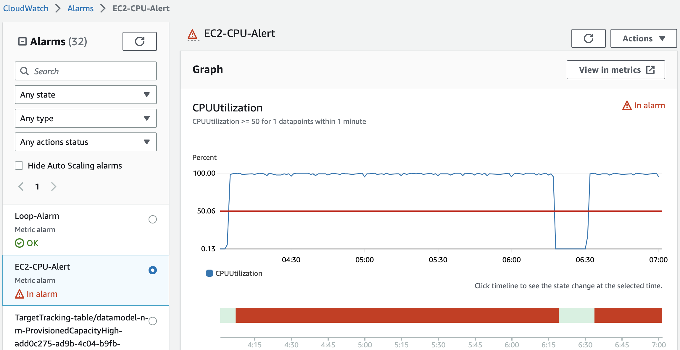
告警源 – EC2 high CPU

Slide 5
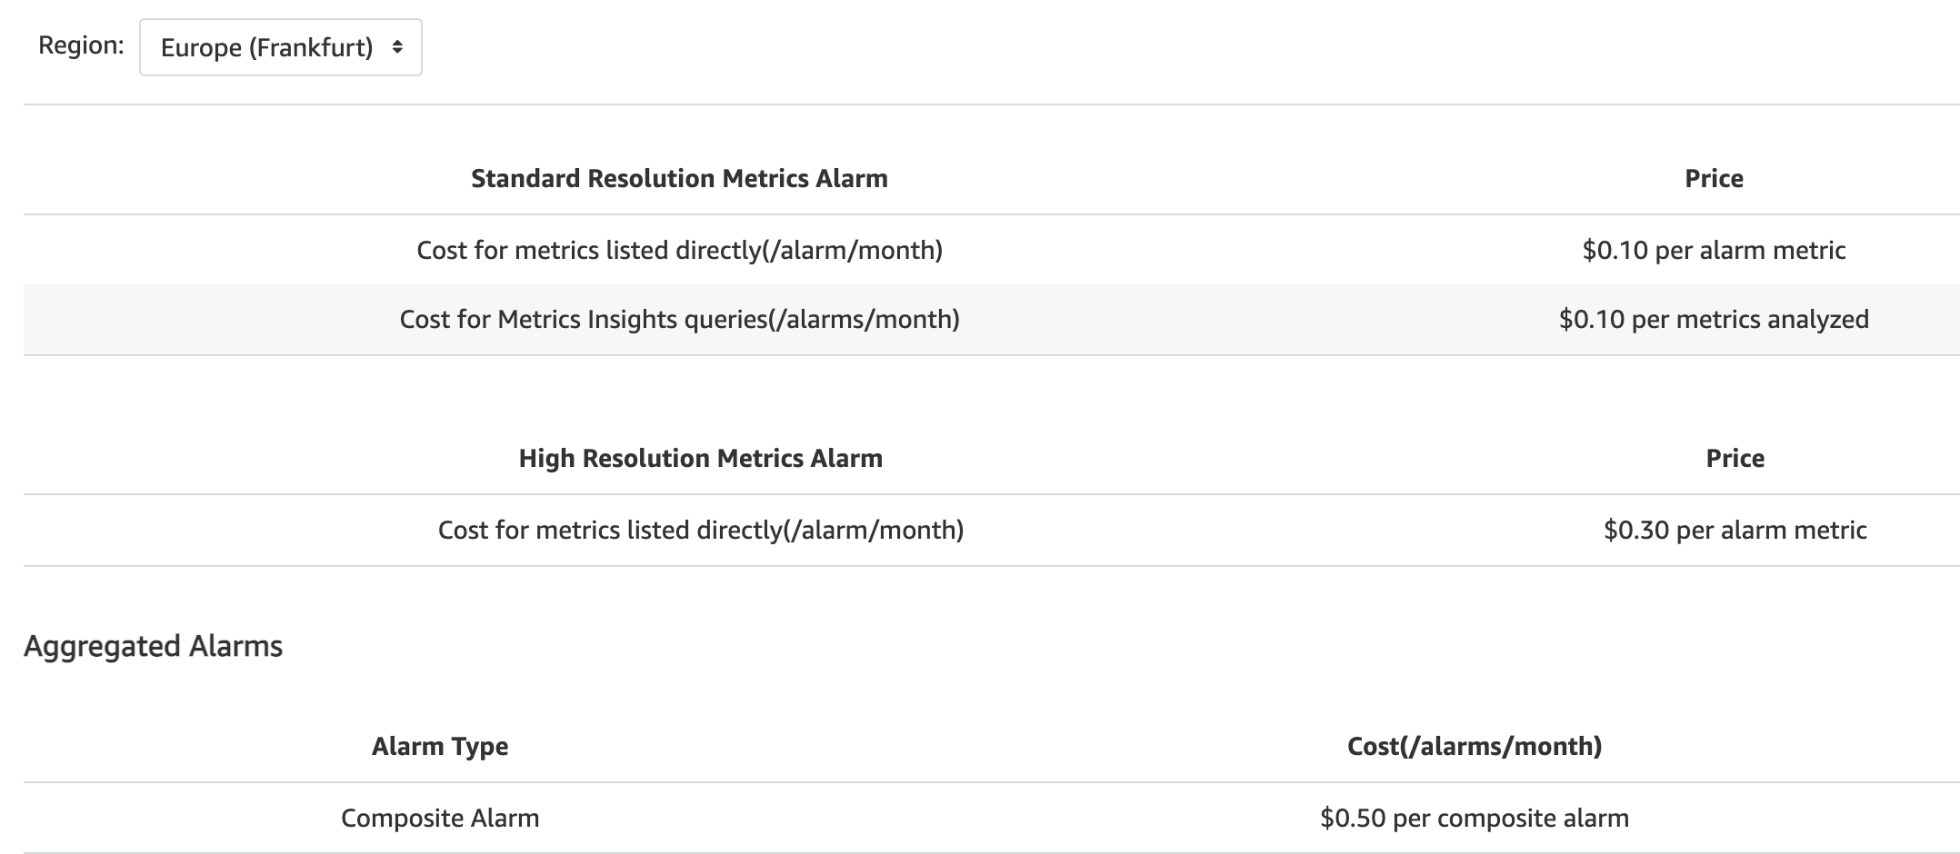
CloudWatch Alarm 定价

Slide 7
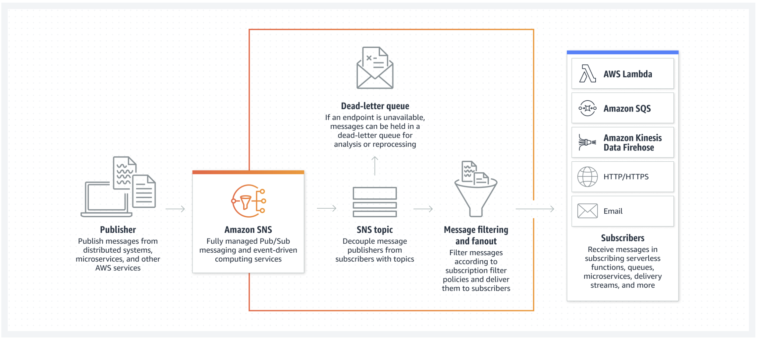
SNS – Simple Notification Service

Slide 8
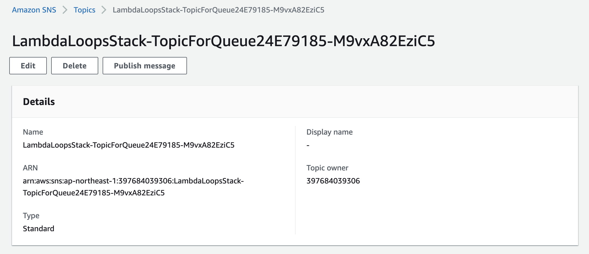
创建SNS通知渠道 – 用来推送到SQS

Slide 9
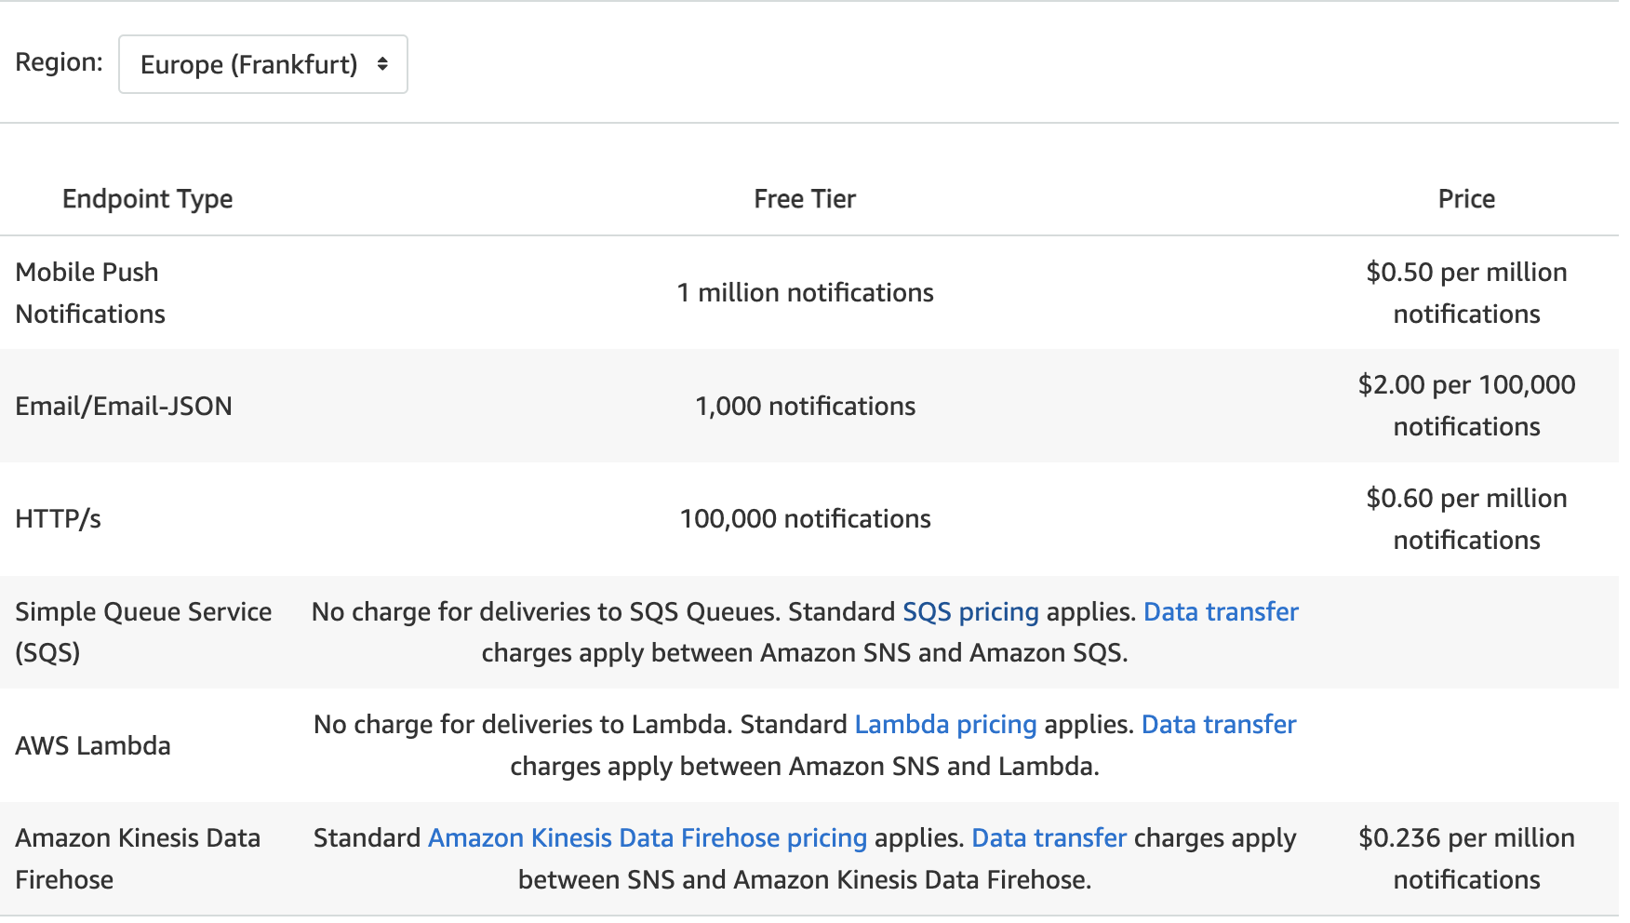
SNS 定价

Slide 10
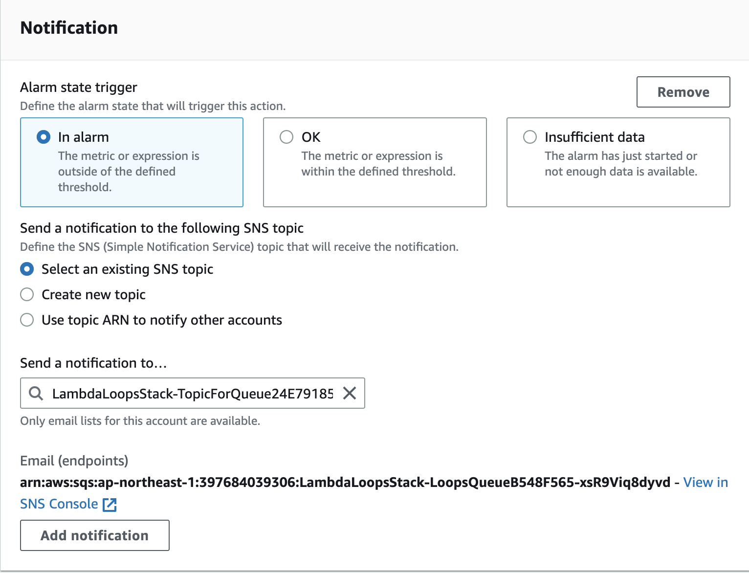
订阅 Cloudwatch Alarm

Slide 12
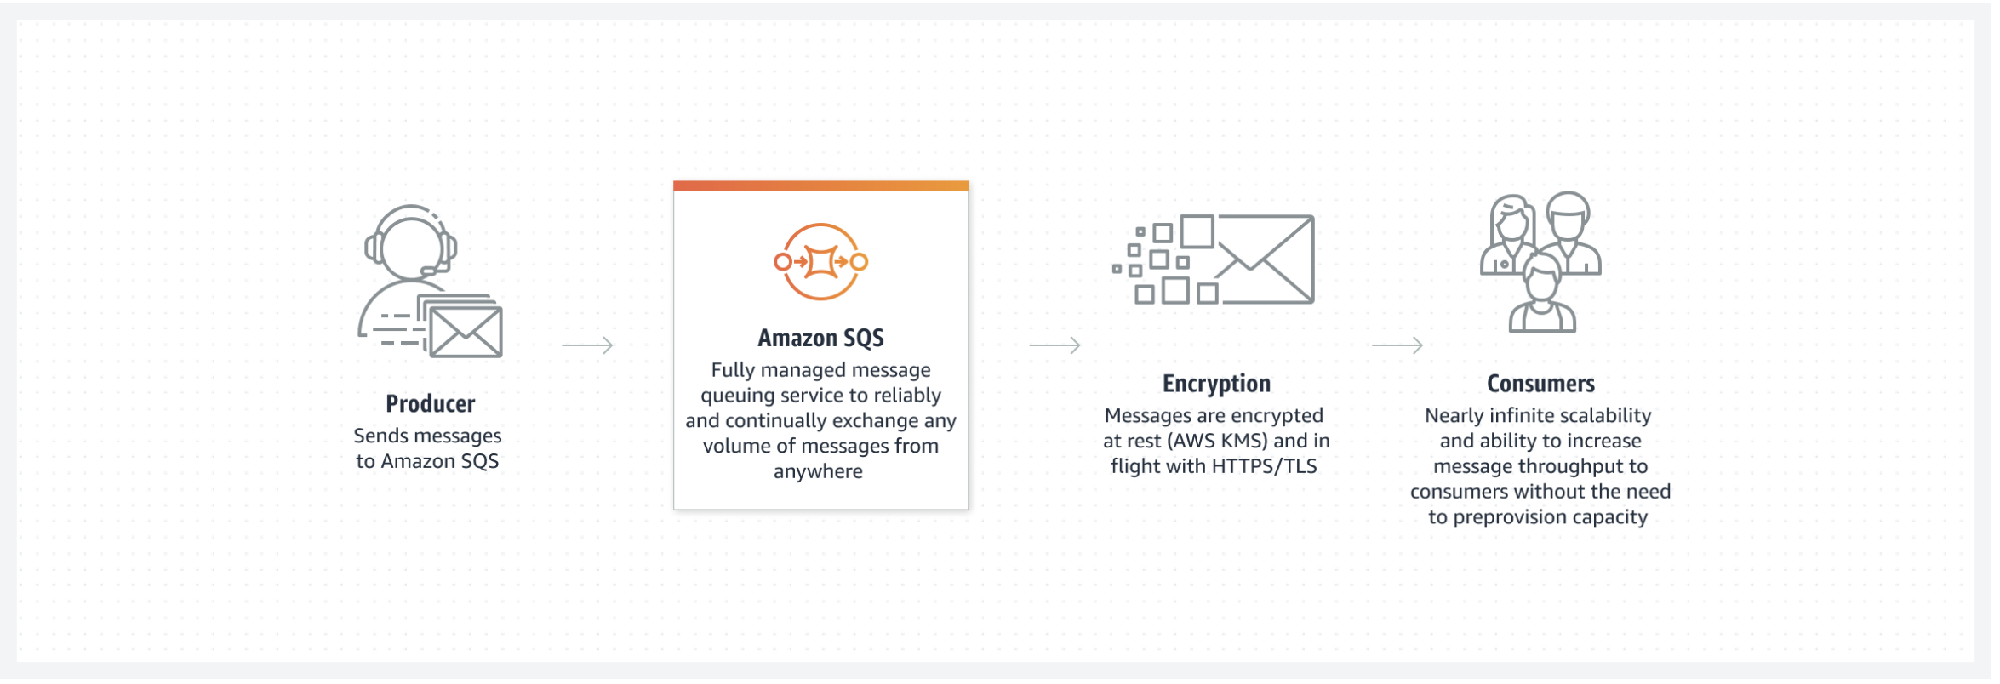
SQS – Simple Queue Service

Slide 13
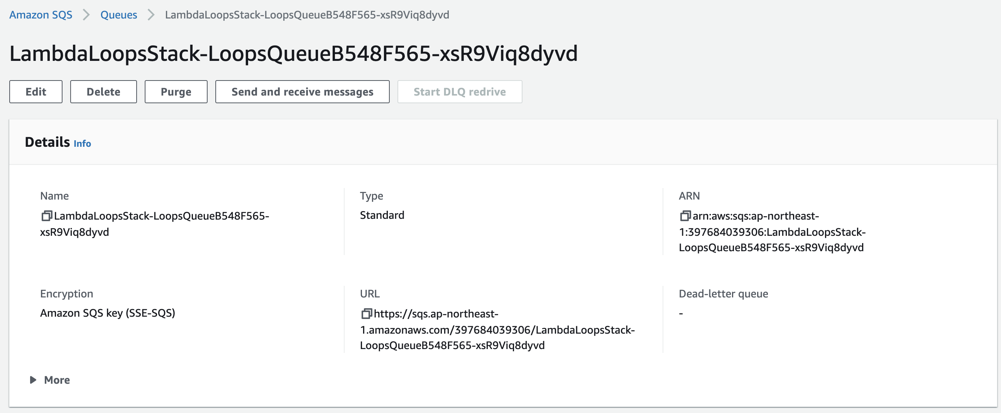
创建 SQS 存放告警消息

Slide 14
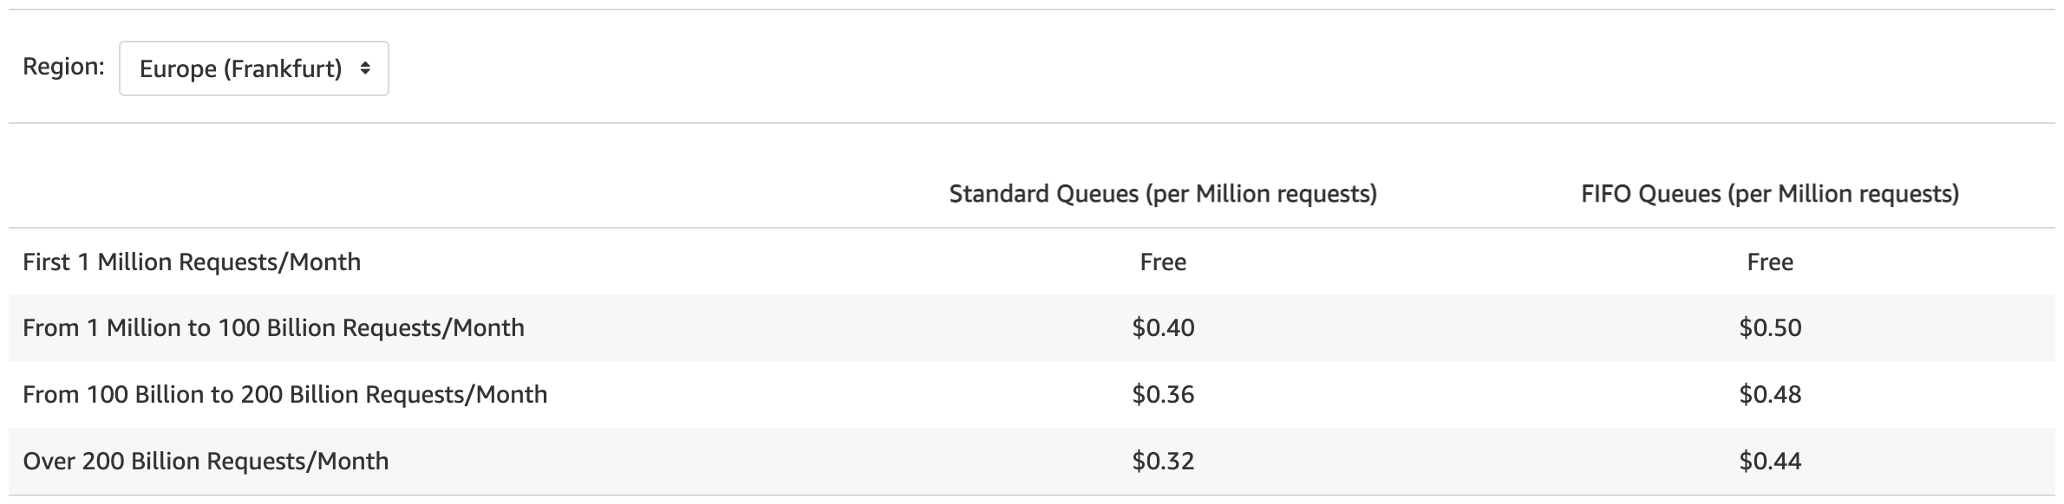
SQS 的定价

Slide 15
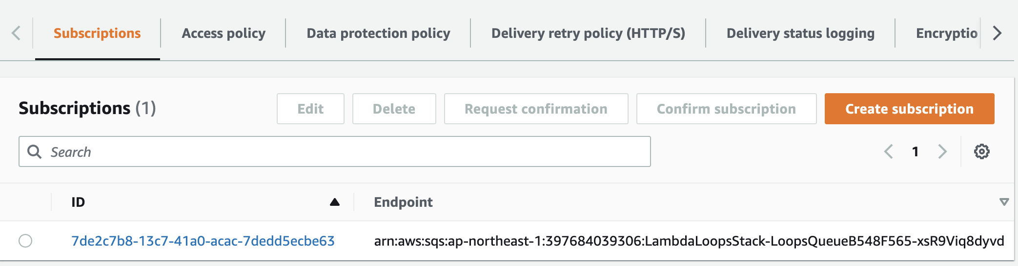
订阅SNS的推送

Slide 17
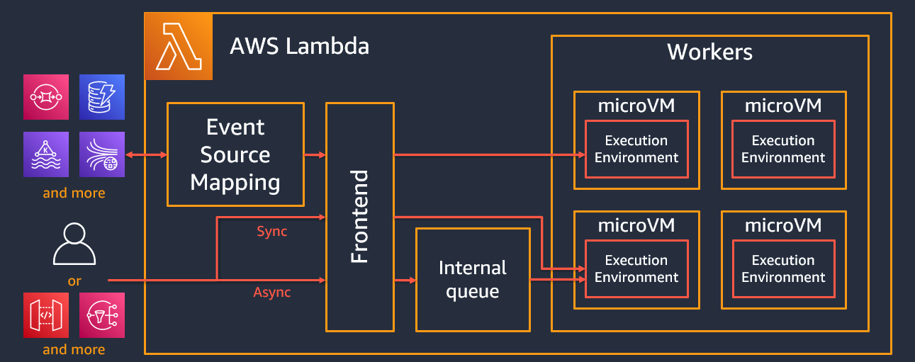
AWS Lambda under the hood

Slide 18

Serverless applications
AWS Lambda
Notes:
Here is a common design pattern with Lambda

Slide 19
Serverless applications
Function
Node.js
Python
Java
C#
Go
Ruby
PowerShell
Runtime API
Notes:
List Currently supported languages
Now supports Node.js 18 AWS Lambda adds support for Node.js 18 (https://aws.amazon.com/about-aws/whats-new/2022/11/aws-lambda-support-node-js-18/) and .NET 6 AWS Lambda adds support for .NET 6
New Release (11/22): SnapStart for Java Functions
AWS Lambda SnapStart for Java delivers up to 10x faster function startup performance at no extra cost. Lambda SnapStart is a performance optimization that makes it easier for you to build highly responsive and scalable Java applications using AWS Lambda, without having to provision resources or spend time and effort implementing complex performance optimizations.
Link: https://aws.amazon.com/about-aws/whats-new/2022/11/aws-lambda-snapstart-java-functions/

Slide 20



Serverless applications
Event source
Function
Changes in
data state
Node.js
Python
Java
C#
Go
Ruby
PowerShell
Runtime API
Requests to
endpoints
Changes in
Resource state

Slide 21
Serverless applications
Event source
Function
Services
Changes in
data state
Node.js
Python
Java
C#
Go
Ruby
PowerShell
Runtime API
Requests to
endpoints
Changes in
Resource state

Slide 22
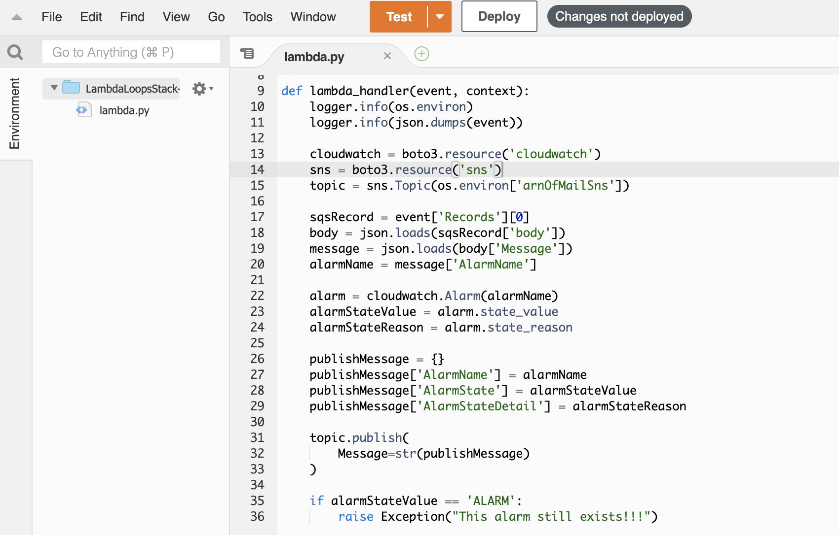
创建 Lambda

Slide 23
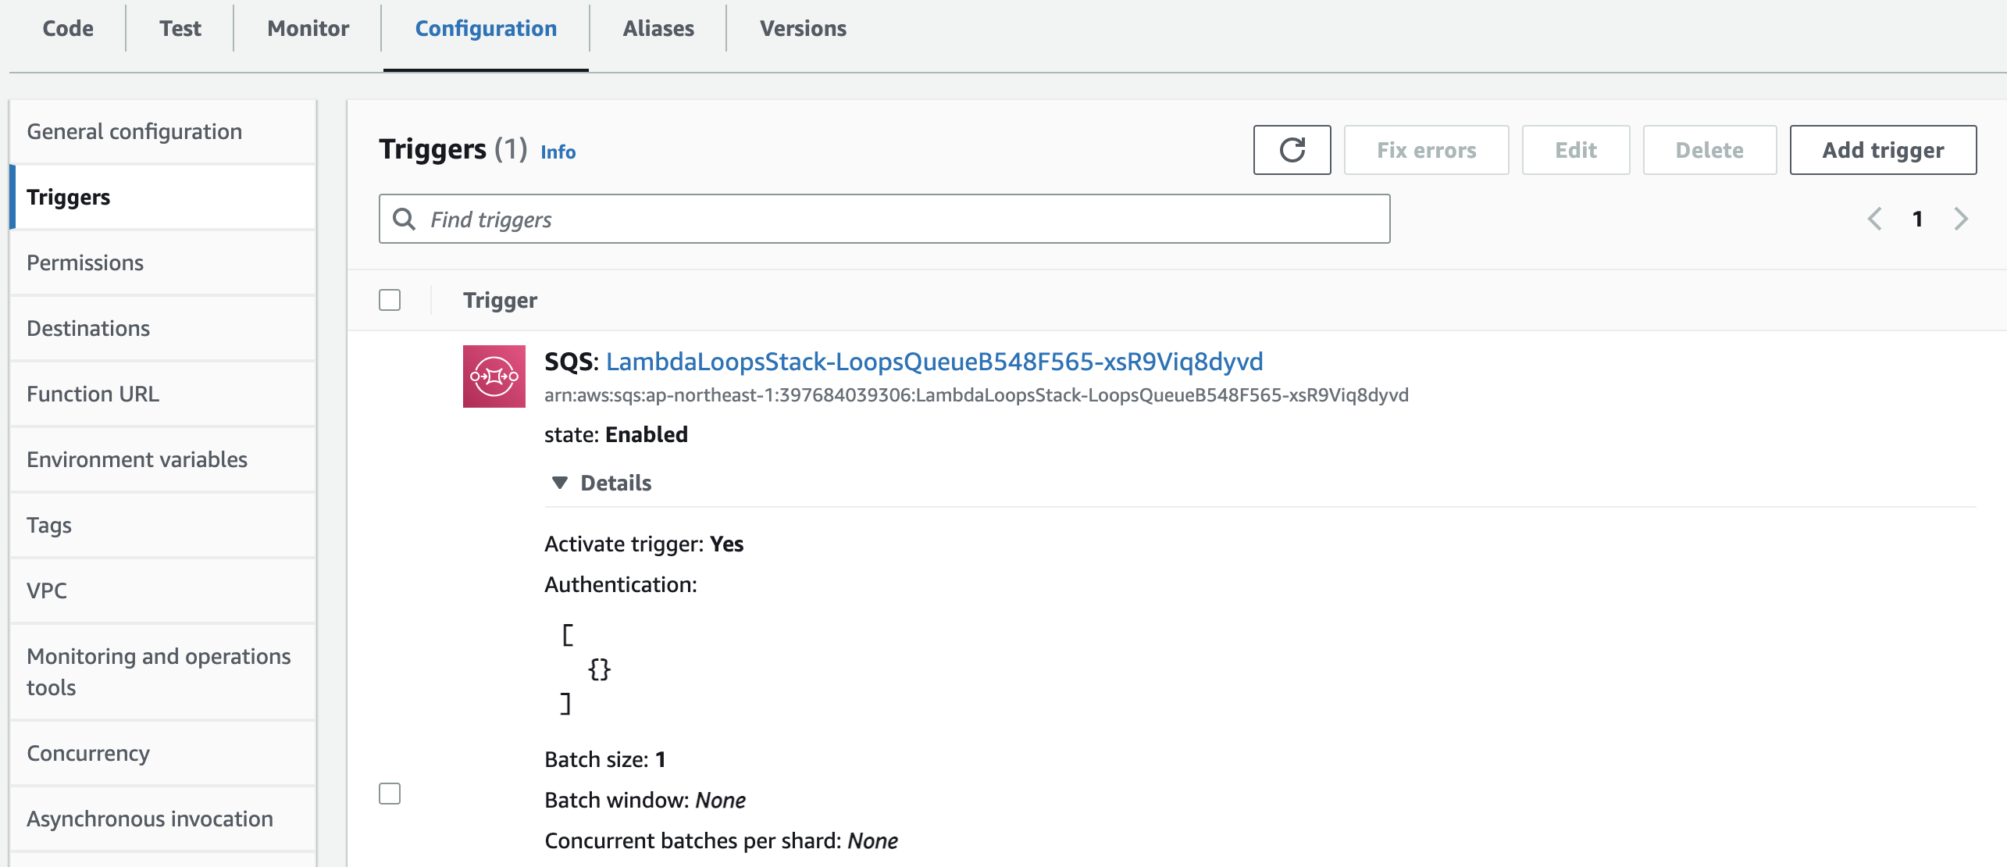
安排 SQS 中的消息触发 Lambda

Slide 24
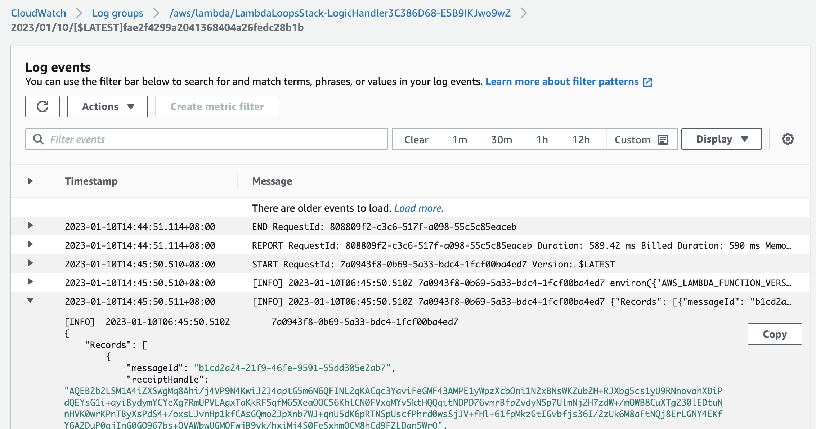
运行日志可以在 CloudWatch 中查阅

Slide 25
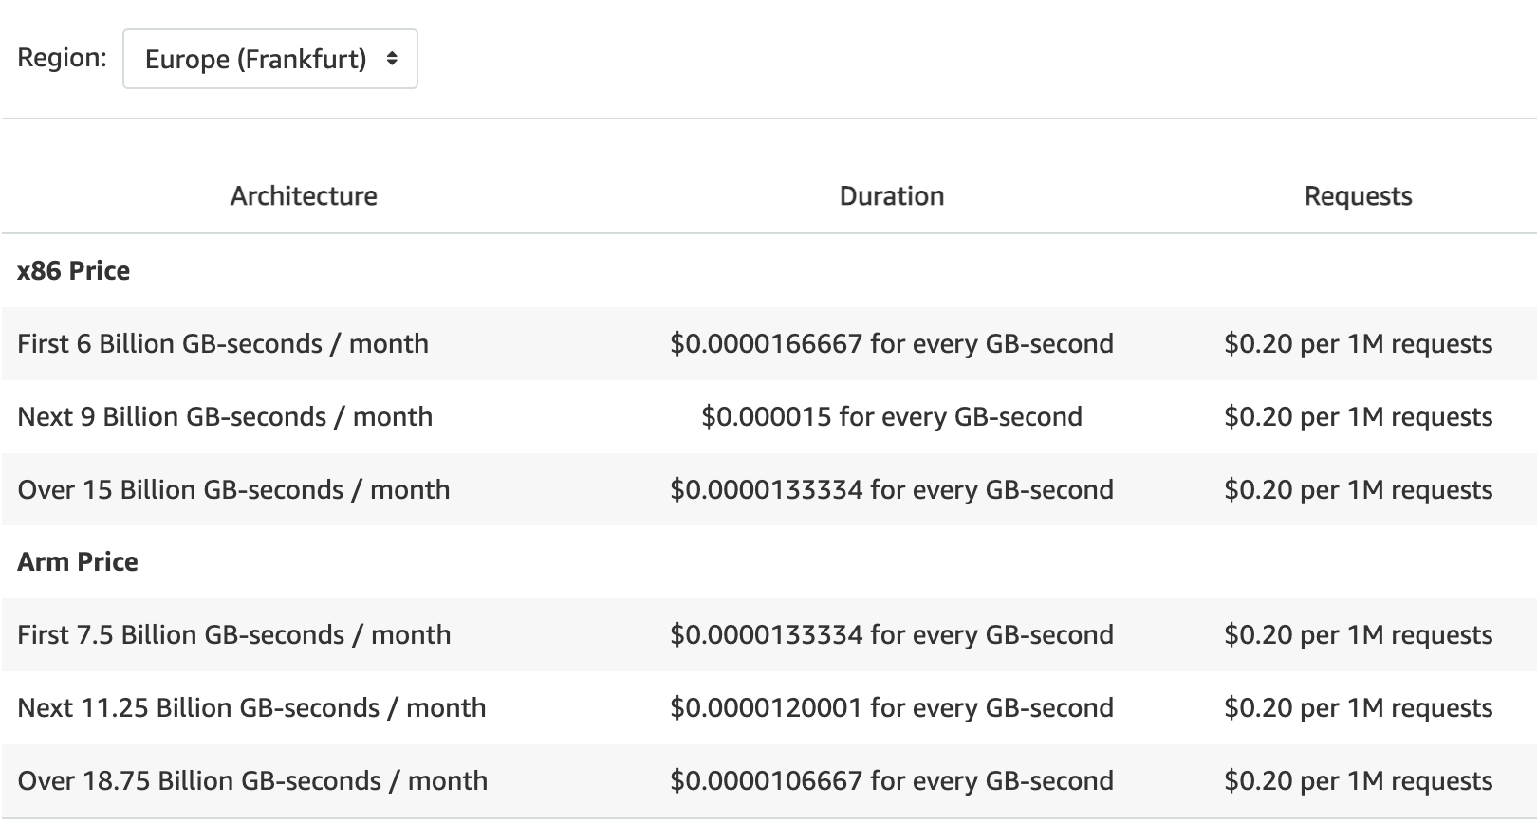
Lambda 定价

Slide 27
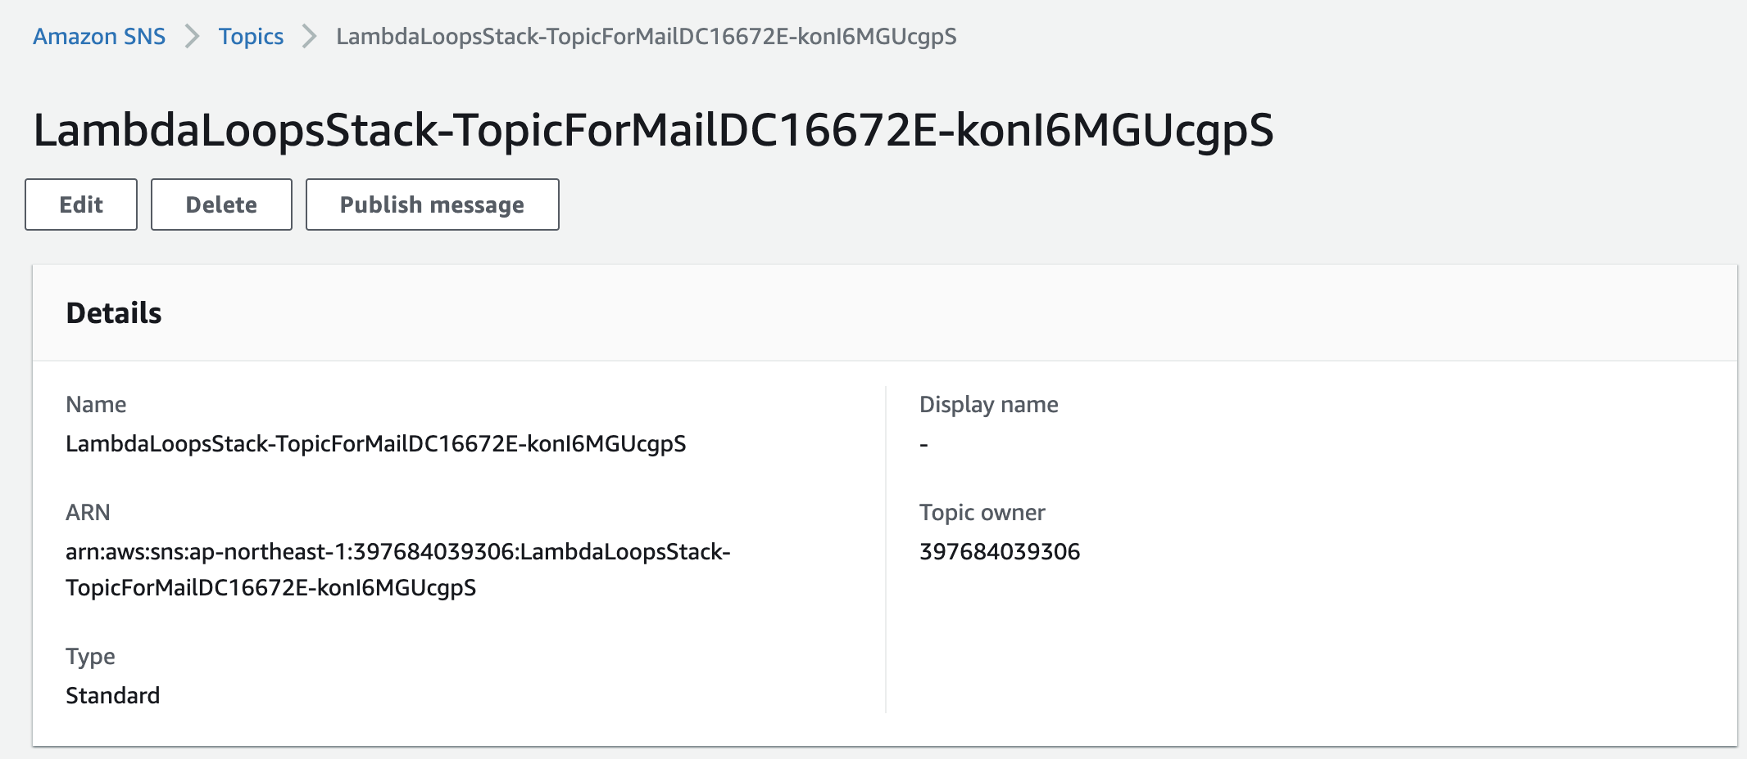
创建SNS通知渠道 – 发送邮件告警

Slide 28
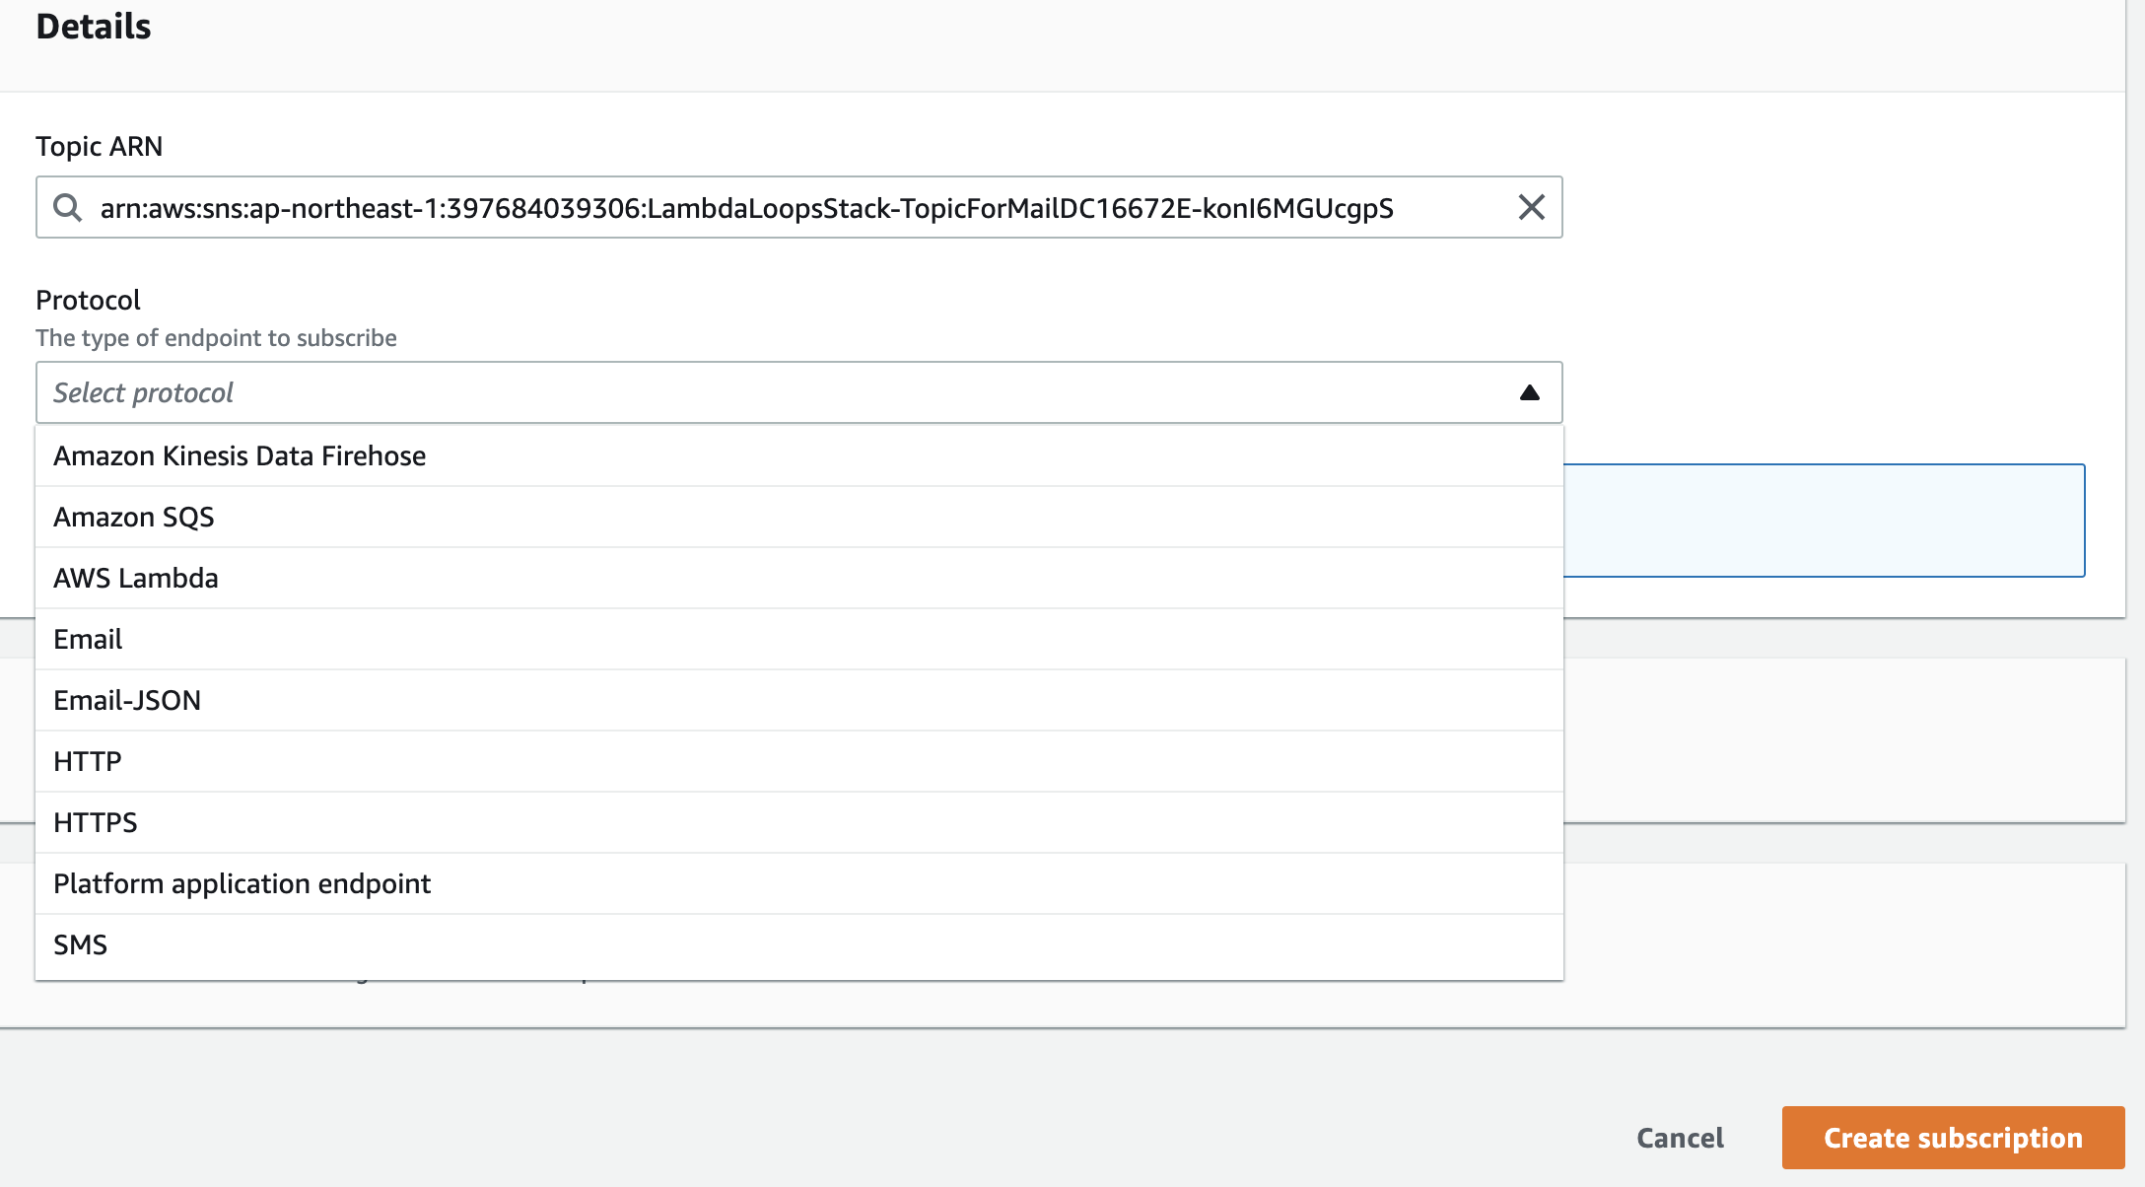
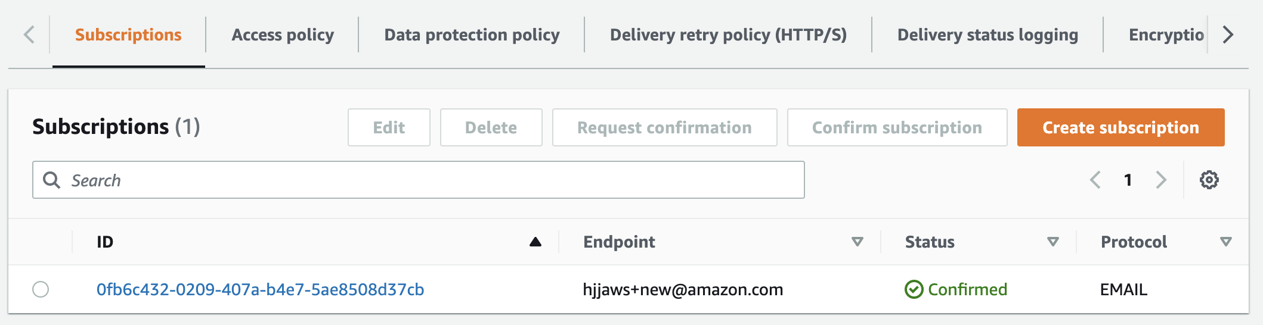
添加通知信箱

Slide 30
Thank You !

